Slide 1
Computation Chemistry
Lecture 11: Electronic Structure in Periodic Systems

Slide 2
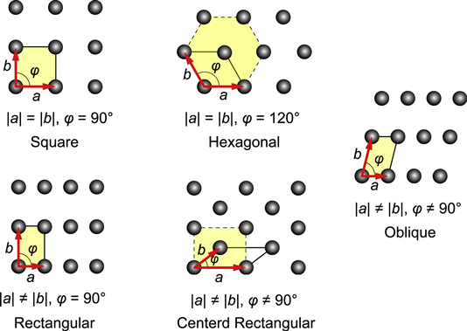
Bravais lattices
2D Example:
Bravais lattices: the distinct lattice types which when repeated can fill the whole space
Wigner-Seitz cell: the most compact cell
First Brillouin zone: the Wigner-Seitz cell of the reciprocal lattice
Five distinct types of Bravais lattices
http://iopscience.iop.org/article/10.1088/0143-0807/35/5/055021

Slide 3
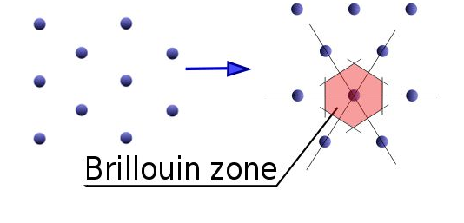





Bravais lattices
2D Example:
Bravais lattices: the distinct lattice types which when repeated can fill the whole space
Wigner-Seitz cell: the most compact cell
First Brillouin zone: the Wigner-Seitz cell of the reciprocal lattice
Reciprocal lattice:
$$\vec{b_{i}}⋅\vec{a_{i}}=2πδ_{ij}$$
$$\vec{b_{1}}$$
$$\vec{a_{2}}$$
$$\vec{a_{1}}$$
$$\vec{b_{2}}$$
real lattice
reciprocal lattice

Slide 4
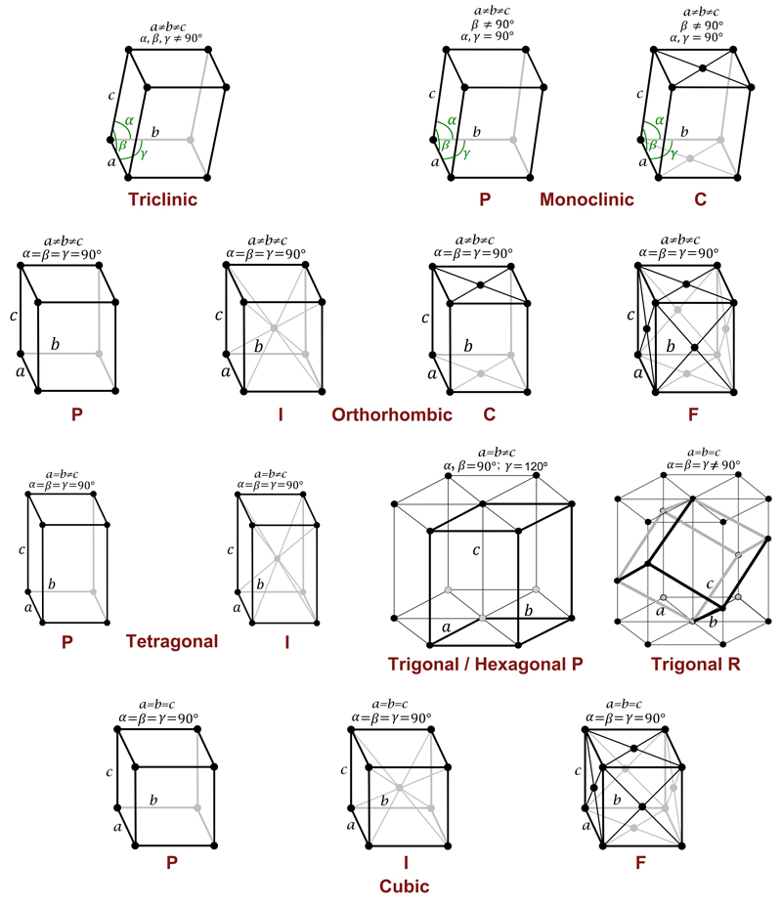
Bravais lattices-3D
14 distinct types of Bravais lattices
7 crystal systems
4 types of centering
http://www.xtal.iqfr.csic.es/Cristalografia/parte_03_4-en.html

Slide 5
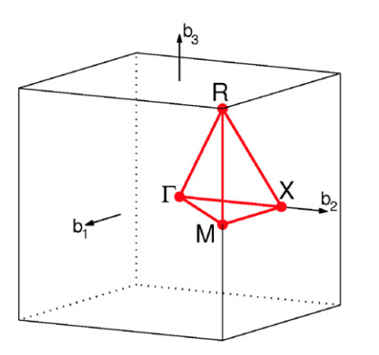
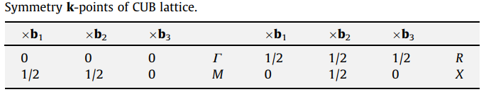
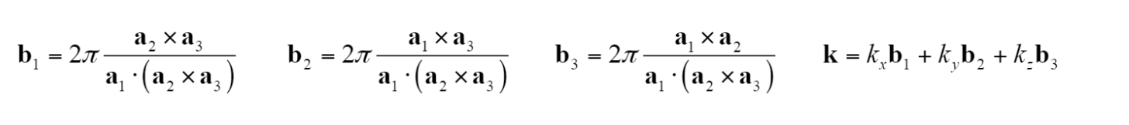
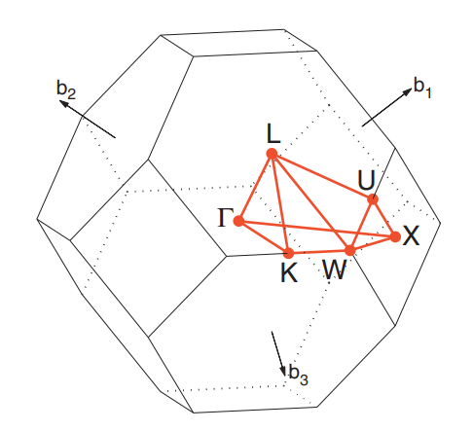
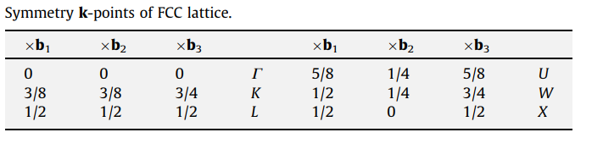

Bravais lattices-3D
Cubic Example:
14 distinct types of Bravais lattices
7 crystal systems
4 types of centering
Reciprocal lattice and the first Brillouin zone
FCC Example:
$$\vec{b_{i}}⋅\vec{a_{i}}=2πδ_{ij}$$
Computational Materials Science 49 (2010) 299–312

Slide 6

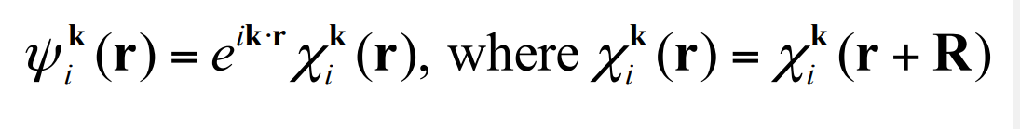

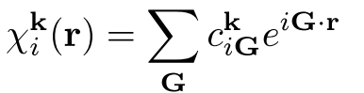

Bloch’s Theorem
Bloch's theorem: the wavefunction of an electron within a periodic potential can be written as the product of a lattice periodic part and a wavelike part:
i: the band index
k: a continuous wavevector that is confined to the first Brillouin zone of the reciprocal lattice
has the same periodicity as the direct lattice, it can be expressed in terms of a discrete plane-wave basis set with wavevectors, that are reciprocal lattice vectors of the crystal, i.e.
The above results show that the electron wavefunctions can be expanded in terms of a linear combination of plane-waves:

Slide 7
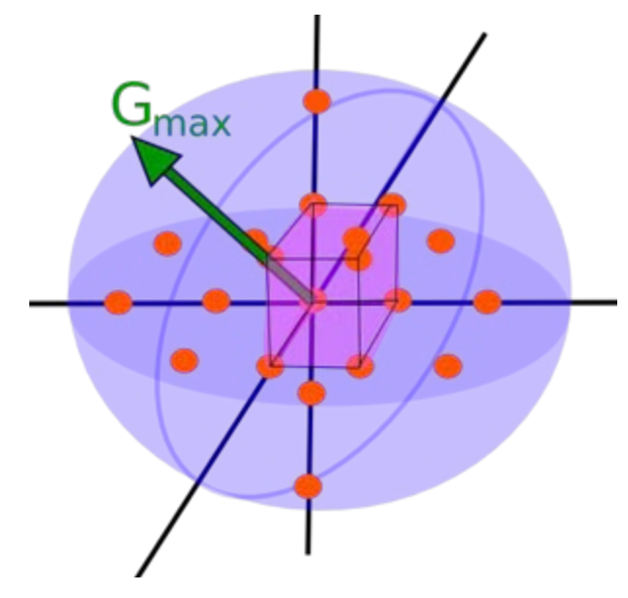
Bloch’s Theorem
Real space lattice: R = n₁ a₁+ n₂ a₂+ n₃ a₃
Reciprocal space lattice: G = n₁ b₁+ n₂ b₂+ n₃ b₃
First Brillouin Zone: k = k_{x} b₁+ k_{y} b₂+ k_{z} b₃
Electron wavefunctions:

Slide 8

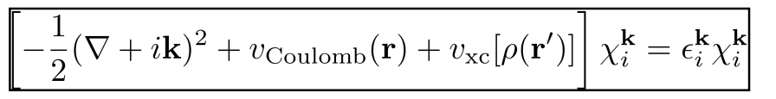
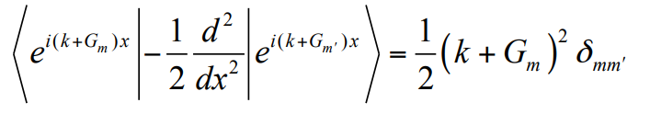
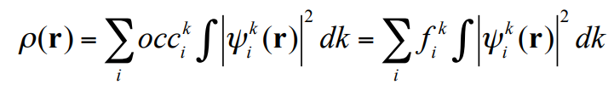
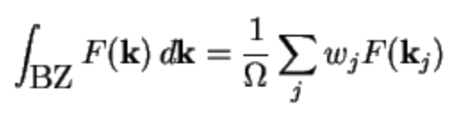
Bloch’s Theorem
Plug into Kohn-Sham equation:
Kinetic energy:
Potential energy:
Integral in k space:
Integration over all k in the first Brillouin zone. This integration cannot be done analytically.
k-point sampling

